Slide 1
Communication Between Modules
Session 06
(Lecture)
Course : Program Design Methods
Effective Period : July 2018

Slide 2
These slides have been adapted from
Simple Program Design : A Step by step approach., Lesley Anne Robertson, Fifth Edition,
Course Technology. ISBN: 978-1-4239-0132-7. Chapter 10
Acknowledgement

Slide 3
LO 4 : Demonstrate the use of program design method
Learning Objectives

Slide 4
Contents
Communication between modules
Programming examples using parameters
Module cohesion
Module coupling

Slide 5
Communication between Modules

Slide 6
Communication between modules
It is necessary to consider the flow of information between modules when designing an algorithm
The flow of information can be accomplished by the scope of the variable (local or global data) or the passing of parameters

Slide 7
Communication between modules
Scope of a variable
  Is the portion of a program in which that variable has been defined and to which it can be refrenced
Global data
  Is data that can be used by all the modules in a program
Local data
  Variables that are defined within a submodule are called variables
Side effects
  Is a form of cross – communication of a module with other parts of a program

Slide 8
Communication between modules
To pass parameters between modules, two things must happen:
  The calling module must name the parameters that it wants to pass to the sub module, at the time of calling
  The sub module must be able to receive those parameters and return them to the calling module, if required
  Example :
  Print_page_heading(pagecount, linecount)

Slide 9
Communication between modules
Formal and actual parameters
  Formal parameter is parameter that appear when a sub module is defined
  Actual parameter is parameter that is passed to a submodule in a particular call
Value and Reference Parameters
  Value parameters pass a copy of the value of a paremeter form one module to another
  Reference paraemeter pass the memory address of a parameter from module to another

Slide 10
Communication between modules
Hierarchy charts and parameters
  Parameters that pass between modules can be incorporated into a hierarchy chart or structure chart using the following symbols
Data parameters
Status parameter

Slide 11
Programming Examples using Parameters

Slide 12
Example
Design a solution algorithm that will prompt a terminal operator for three characters, accept those characters as input, sort them into ascending sequence and output them to the screen. The algorithm is to continue to read characters untuk ‘XXX’ is entered
Defining Diagram
Input | Processing | Output
char_1 char_2 char_3 | Prompt for characters Accept three characters Sort three characters Output three | char_1 char_2 char_3

Slide 13
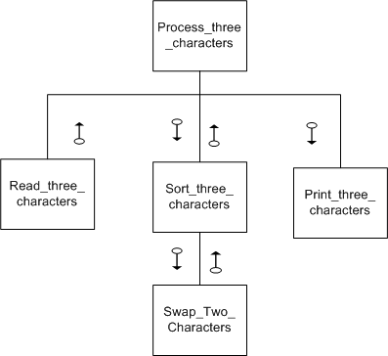
Example
Hierarchy Chart

Slide 14
Example
Solution algorithm
Process_three_characters
Read_three_characters(char1, char2, char3)
DOWHILE NOT (char1=‘X’ AND char2=‘X’ AND char3=‘X’)
Sort_three_charcters(char1,char2,char3)
Print_three_characters(char1, char2, char3)
Read_three_characters(char1,char2,char3)
END
Read_three_characters(char1, char2, char3)
prompt the operator for char_1,char_2,char_3
get char_1,char_2,char_3
END
Print_three_characters(char1,char2,char3)
output to the screen char, char2, char3
END

Slide 15
Example
Solution algorithm
Sort_three_characters(char1,char2,char3)
IF char1>char2 THEN
Swap_two_characters(char1, char2)
ENDIF
IF char2>char3 THEN
Swap_two_characters(char2, char3)
ENDIF
IF char1>char2 THEN
Swap_two_characters(char1, char2)
ENDIF
END
Swap_two_characters(firstchar,secondchar)
temp = firstchar
firstchar = secondchar
secondchar = temp
END

Slide 16
Module Cohesion

Slide 17
Cohesion
Cohesion is a measure of the internal strength of a module; it indicates how closely the elements or statements of a module are associated with each other

Slide 18
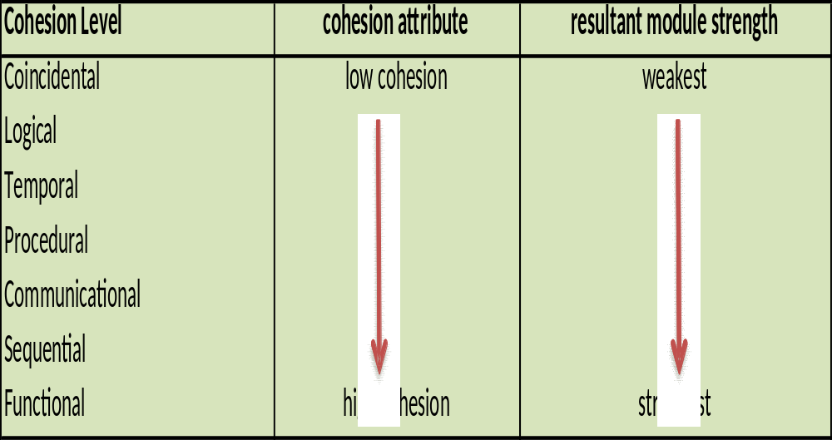
Cohesion Level

Slide 19
Coincidental cohesion
Coincidental cohesion occurs when elements are collected into a module simply because they happen to fall together
There is no meaningful relationship between the elements at all and so it is difficult to concisely define the function of the module
Example
File_processing
open employee updates file
read employee record
print_page_heading
open employee master file
set page_count to one
set error_flag to false
END

Slide 20
Logical cohesion
Logical cohesion occurs when the elements of a module are grouped together according to a certain class of activity. That is, the elements fall into some general category because they all do the same kind of thing
Example
Read_all_files(file_code)
CASE of file_code
1 : Read customer transaction record
IF not EOF
increment customer_transaction_count
ENDIF
2 : Read customer master record
IF NOT EOF
increment customer_master_count
ENDIF
3 : Read product master record
IF NOT EOF
increment product_master_count
ENDIF
ENDCASE
END

Slide 21
Temporal cohesion
Temporal cohesion occurs when the elements of a module are grouped together because they are related by time
Example
  Initialisation
  open transaction file
  read transaction record
  transaction_count = 0
  line = 0
  number = 0
  END

Slide 22
Procedural Cohesion
Procedural cohesion occurs when the elements of a module are related because they operate according to a particular procedure. That is, the elements are executed in a particular sequence so that the objectives of the program are achieved
Example
Read_student_record_and_total_student_ages
set number_of_records to zero
set total_age to zero
read student record
DOWHILE more records exist
add age to total_age
add 1 to number_of_records
ENDDO
print number_of_records, total_age
END

Slide 23
Communicational cohesion
Communication cohesion occurs when the elements of a module are grouped together because they are all operate on the same (central) piece of data
Example:
validate_product_record
IF transaction_type NOT=‘0’’ THEN
error_flag = true
error_message = ‘invalid transaction type’
print_error_report
ENDIF
IF customer_number is NOT= numeric THEN
error_flag = true
error_message = ‘invalid customer number’
print_error_report
ENDIF
IF product_no = blanks OR produc_no has leading blanks THEN
error_flag = true
error_message = ‘invalid product no’
print_error_report
ENDIF
END

Slide 24
Sequential Cohesion
Sequential cohesion occurs when a module contains elements that depend on the processing of previous elements.
Example :
Process_purchases
set total_purchases to zero
prompt and get number_of_purchases
DO loop_index = 1 to number_of_purchases
prompt and get pruchase
add purchase to total_purchases
ENDDO
sales_tax = total_purchases*sales_tax_percent
amount_due = total_purchases + sales_tax
END

Slide 25
Functional Cohesion
Functional cohesion occurs when all the elements of a module contribute to the performance of a single specific task.
Example :
Calculate_sales_tax
IF price < $50 THEN
sales_tax = product_price * 0.25
ELSE
IF price < $100 THEN
sales_tax = product_price * 0.20
ELSE
sales_tax = product_price * 0.10
ENDIF
ENDIF
END

Slide 26
Module Coupling

Slide 27
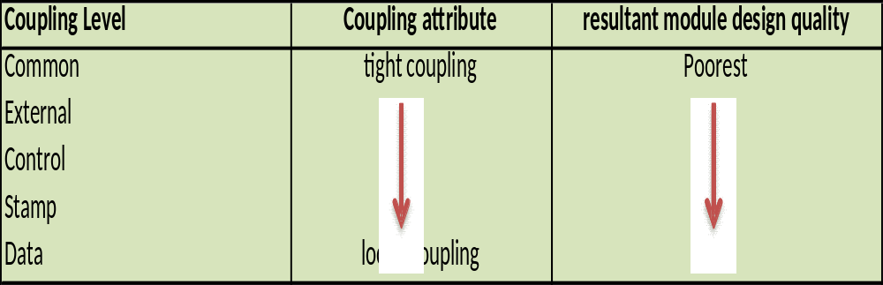
Module coupling
Coupling is a measure of the extent of information interchange between modules. Tight coupling implies large dependence on the structure of one module by another

Slide 28
Data coupling
Data coupling occurs when a module passes a non-global data variable to another module.
Module A
Elementary data item
Module B

Slide 29
Data coupling
Contoh:
Process_customer_record
…
…
calculate_sales_tax(total_price, sales_tax)
…
…
B. Calculate_sales_tax
IF total_price > 5000 THEN
sales_tax = total_price * 0.25
Else
If total_price > 4000 THEN
sales_tax = total_price * 0.2
Else
sales_tax = total_price * 0.15
ENDIF
ENDIF
END

Slide 30
Stamp coupling
Stamp coupling occurs when one module passes a non-global data structure to another module in the form of a parameter
Module A
Data structure
Module B

Slide 31
Stamp coupling
example:
Process_transaction_record
….
process_male_student (current_record)
…
END
Proses_male_student (current_record)
increment male_student_count (current_record)
If student_age > 21 THEN
increment_mature_male_count
ENDIF
….
….
END

Slide 32
Control coupling
Control coupling occurs when a module passes to another module a control variable that is intended to control the second module’s logic
Module A
Parameter Kontrol
Module B

Slide 33
Control coupling
example:
Process_input_code
read input_code
choose_appropriate_action (input_code)
…
…
END
Choose_appropriate_action (input_code)
CASE OF input_code
1 : read employee record
2 : print_page_heading
3 : open employee master file
4 : set page_count to zero
5 : error_message =‘Employee number not numeric’
ENDCASE
END

Slide 34
External coupling
External coupling occurs when two or more modules access the same global data variable
Global Data Elementary
Modul A
Modul B

Slide 35
External coupling
Example:
Calculate_sales_tax
IF product is sales exempt THEN
sales_tax = 0
ELSE
IF product_price < $50 THEN
sales_tax = sales_price * 0.25
….
…
ENDIF
ENDIF
Calculate_amount_due
…
amount_due = total_amount + sales_tax
…
END

Slide 36
Common coupling
Common coupling occurs when modules reference the same global data structure
global data structure
Module A
Module B

Slide 37
Common coupling
Example :
Read_customer_record
read customer record
IF EOF THEN
set EOF_flag to true
ENDIF
END
Validate_customer_record
IF customer_number is NOT numeric THEN
error_message = ‘invalid customer number’
print_error_report
ENDIF
…
….
END

Slide 38
References
Simple Program Design : A Step by step approach., Lesley Anne Robertson, Fifth Edition,
Course Technology. ISBN: 978-1-4239-0132-7.
Cohesion and coupling, http://en.wikipedia.org/wiki/Coupling_%28computer_programming%29

Slide 39
Q & A

